Slide 1
Self-supervised Long-tailed Learning
2024.3.14

Slide 2
Supervised Long-tailed Learning & Self-supervised Long-tailed Learning
2. Temperature schedules for self-supervised contrastive methods on long-tail data.
ICLR 2023 poster.
3. Combating Representation Learning Disparity with Geometric Harmonization.
NeurIPS 2023 spotlight.

Slide 3
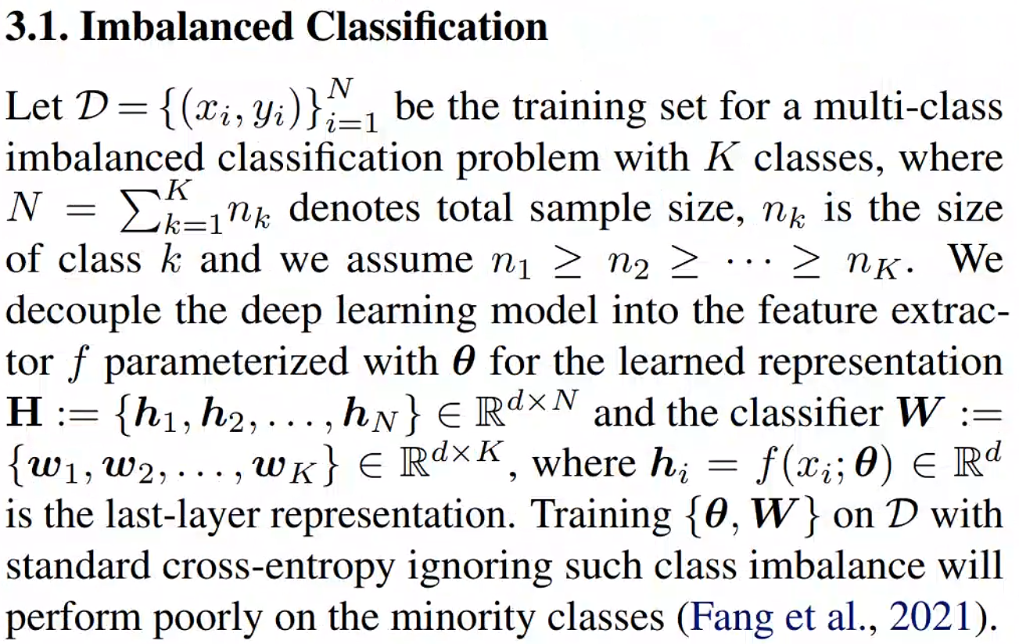
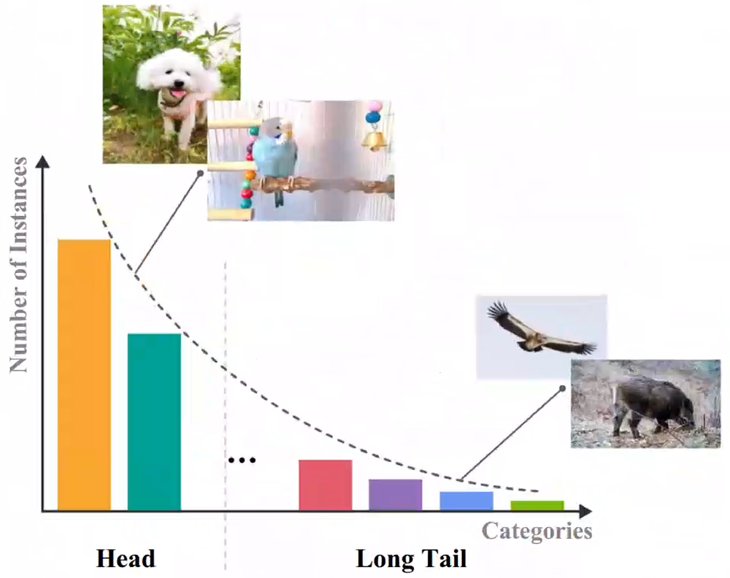
Supervised Long-tailed Learning

Slide 4
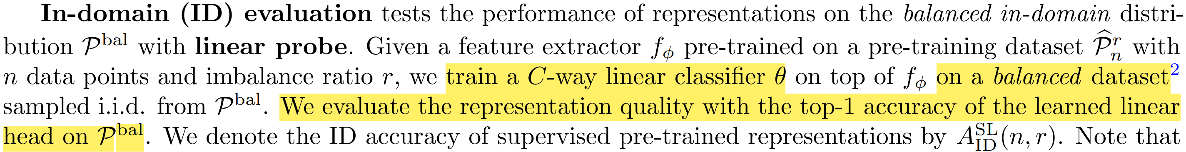
Self-supervised Long-tailed Learning
Unlabeled data during training
Evaluate method

Slide 5
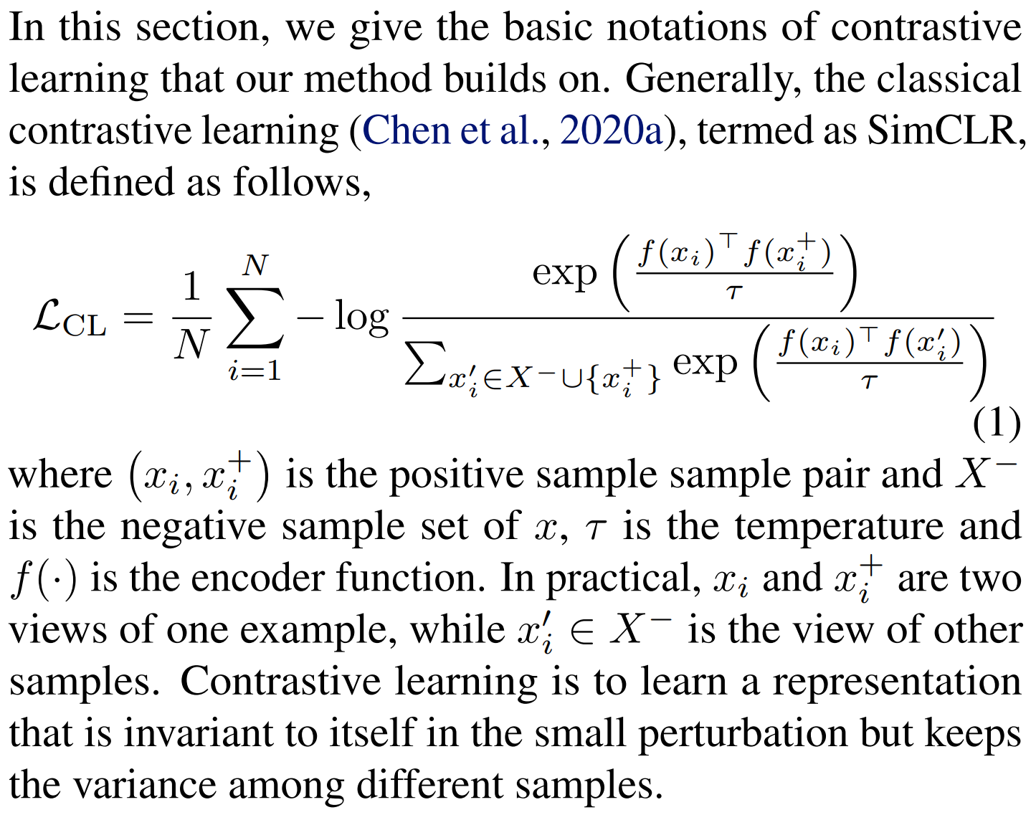
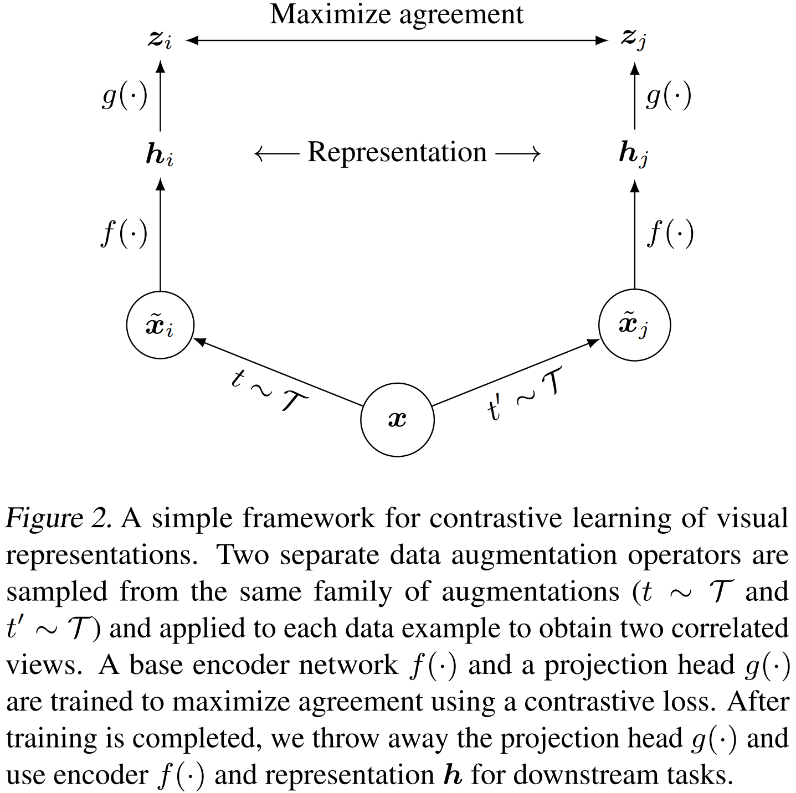
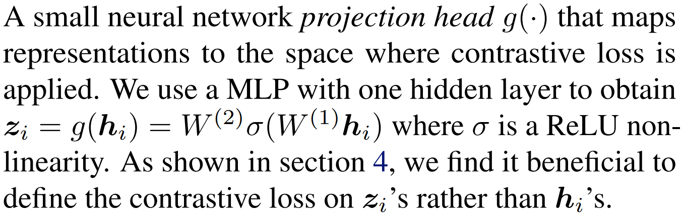
Contrastive Learning

Slide 6
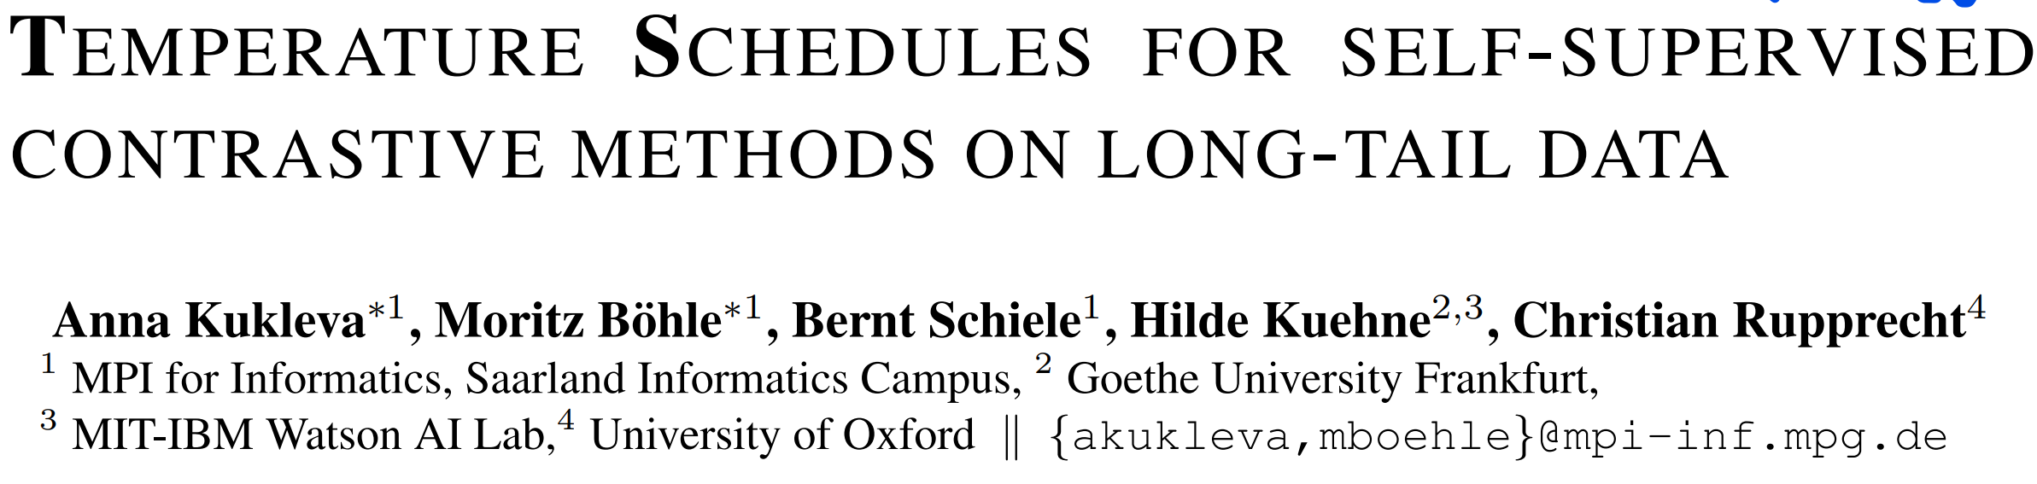
ICLR 2023 poster

Slide 7
Motivation: we investigate the role of the temperature parameter τ as a constant hyperparameter in the contrastive loss, by analysing the loss through the lens of average distance maximization on long-tail data.
Contributions:
We propose to employ a dynamic τ and show that a simple cosine schedule can yield significant improvements in the learnt representations.
Such a schedule results in a constant ‘task switching’ between an emphasis on instance discrimination (infrequent classes) and group-wise discrimination (frequent classes) and thereby ensures that the model learns both group-wise features, as well as instance-specific details.
We find this method to consistently improve separation between the classes on long-tail data without any additional computational cost.
Conclusion: large τ → head ↑ & Small τ → tail ↑

Slide 8
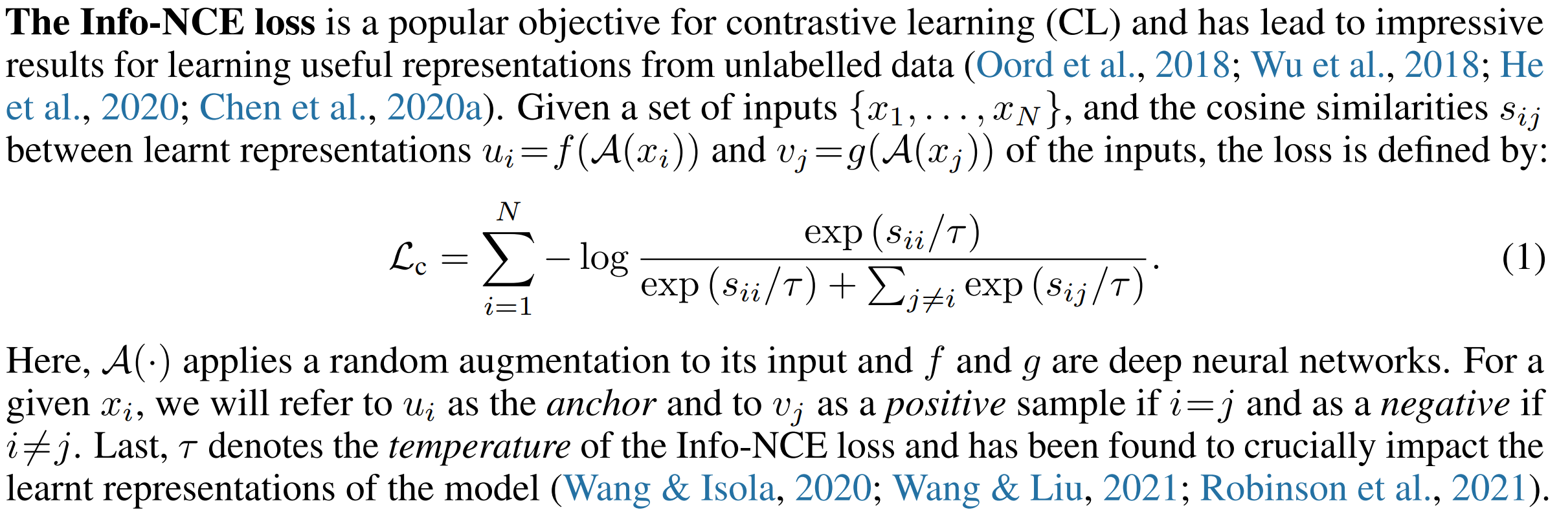
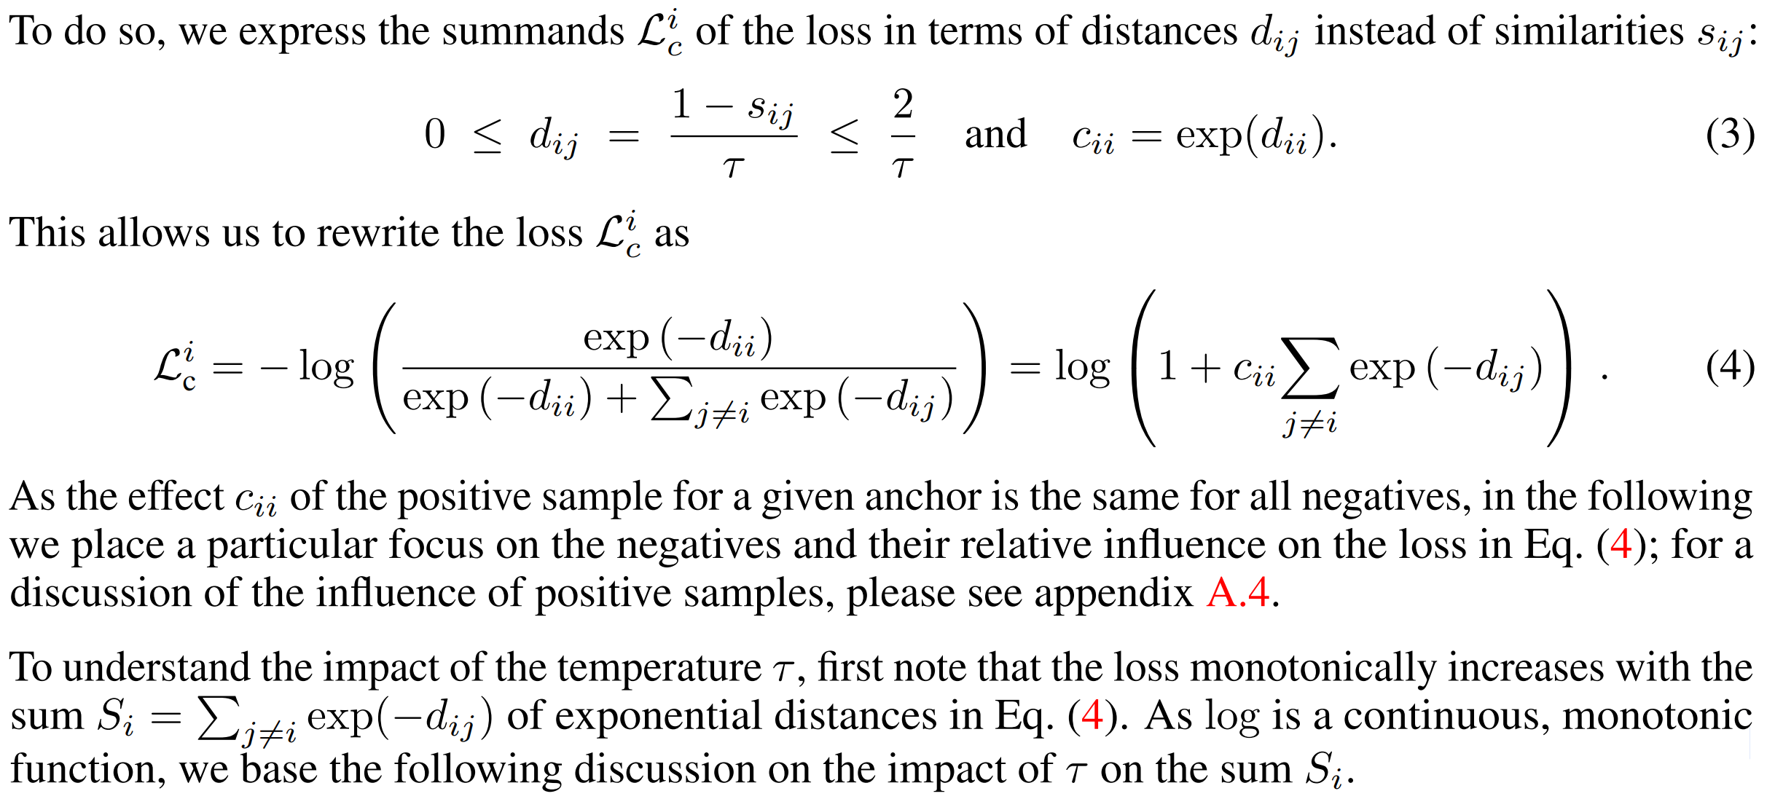

Slide 9
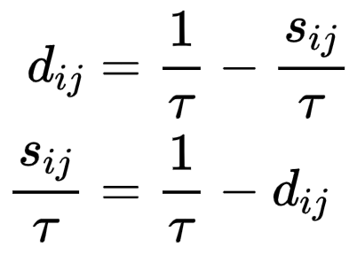
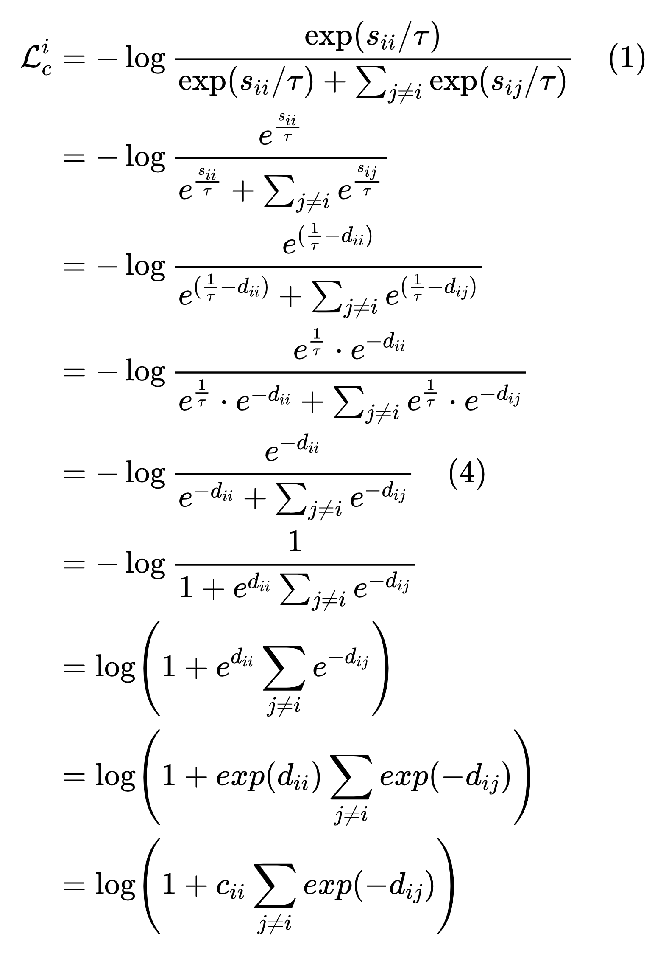

Slide 10
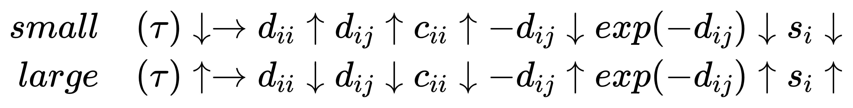

Slide 11
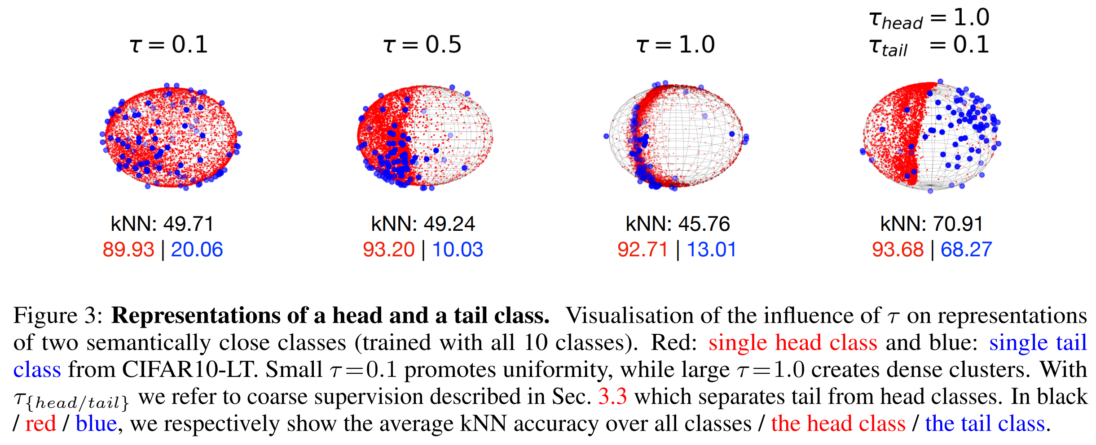

Slide 12
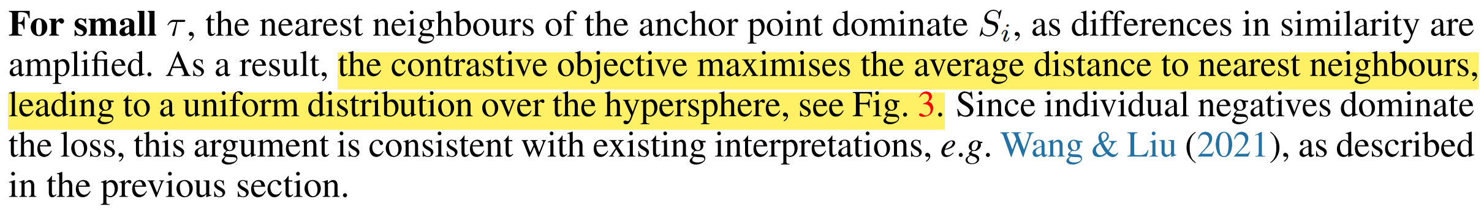
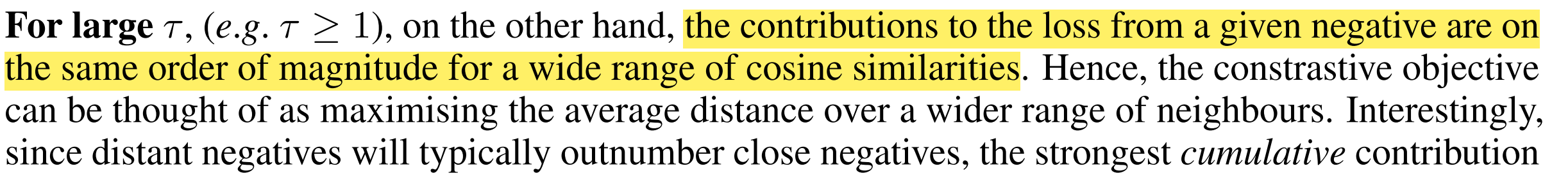
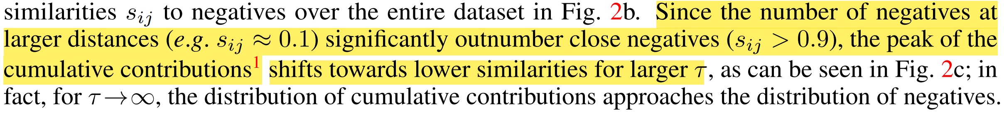

Slide 13
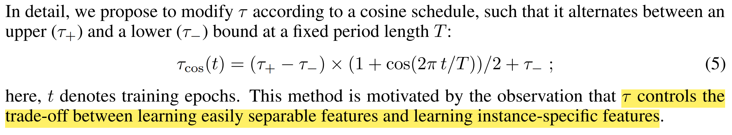
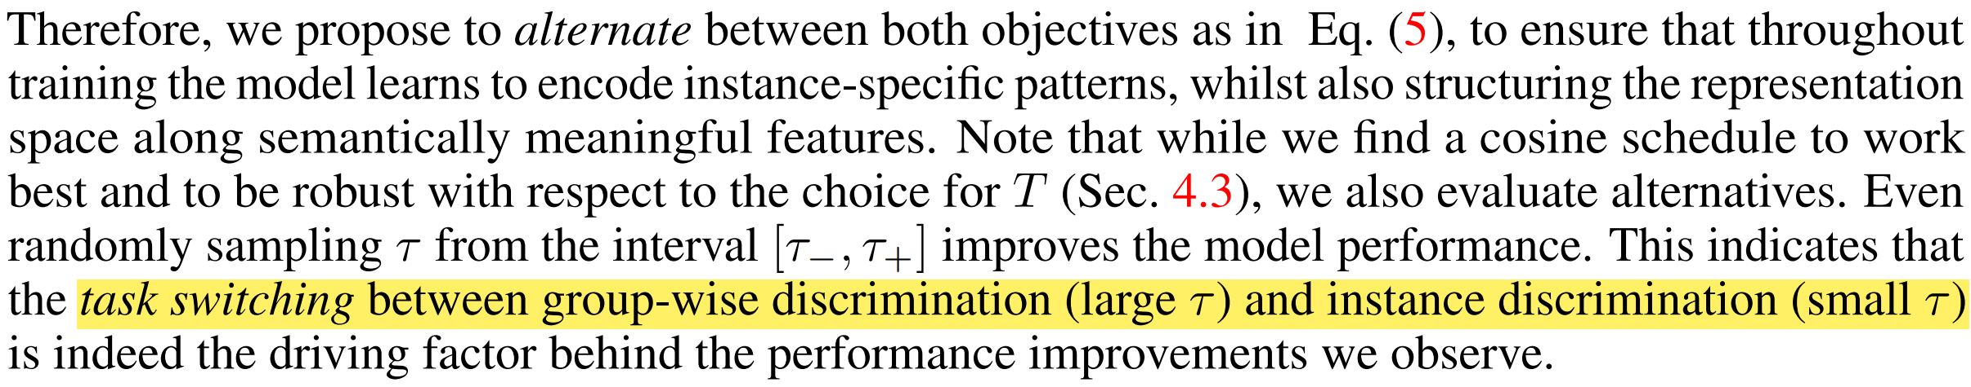

Slide 14
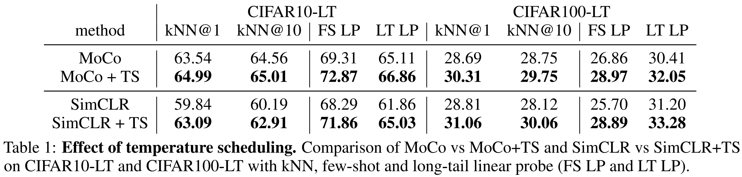
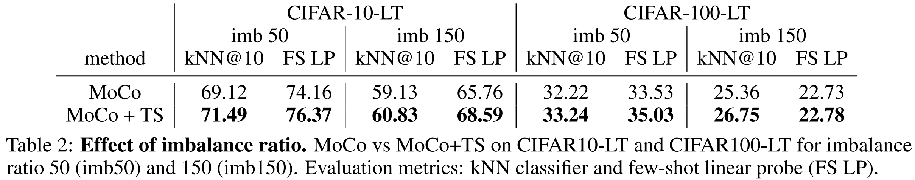
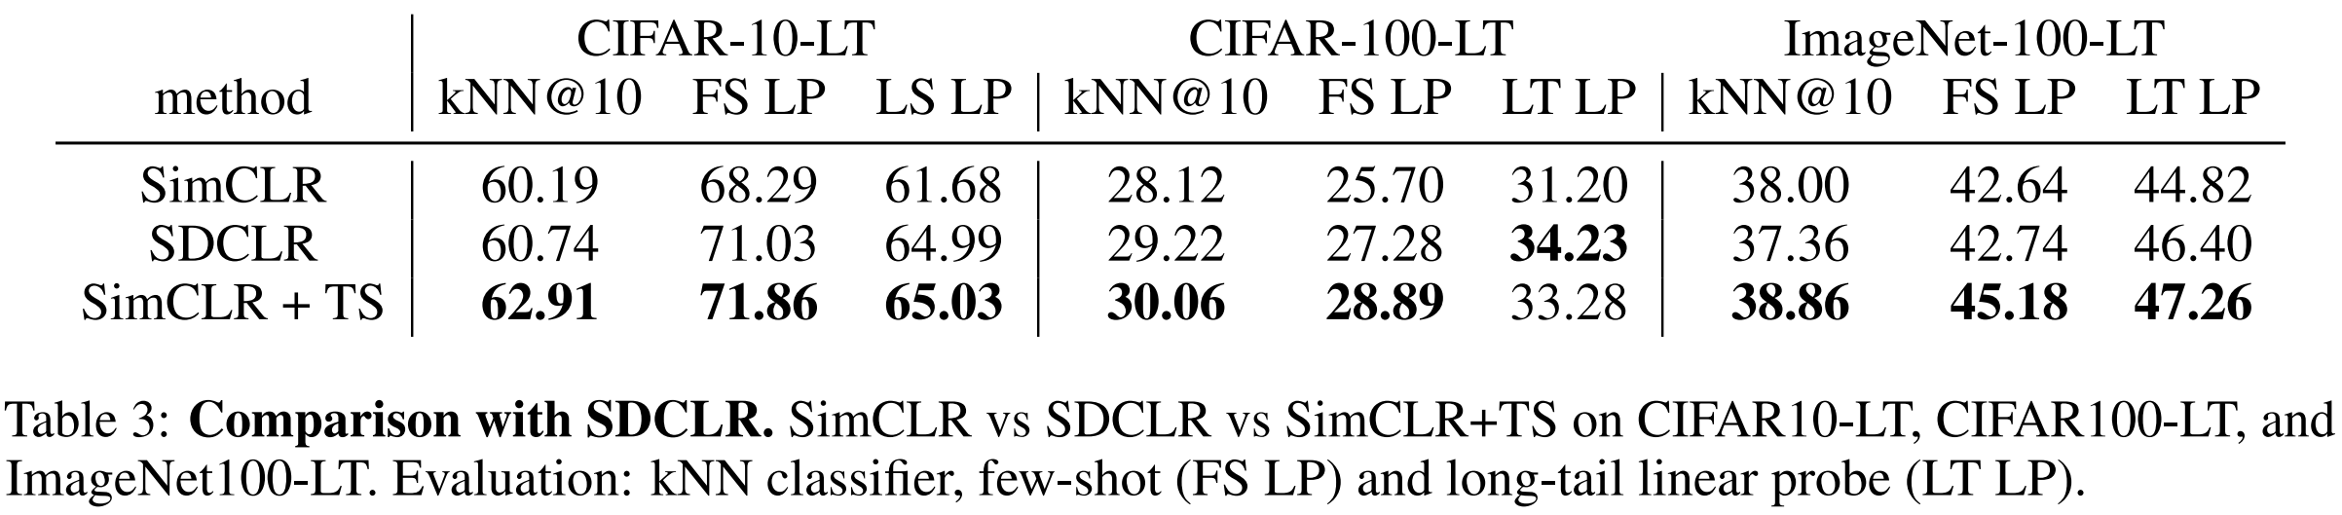

Slide 15
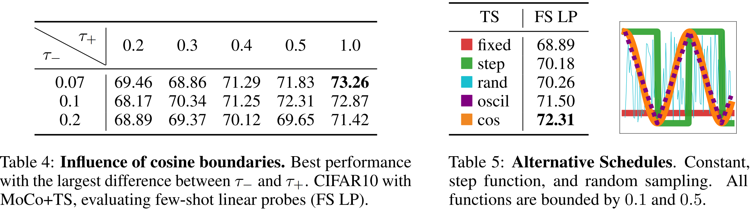
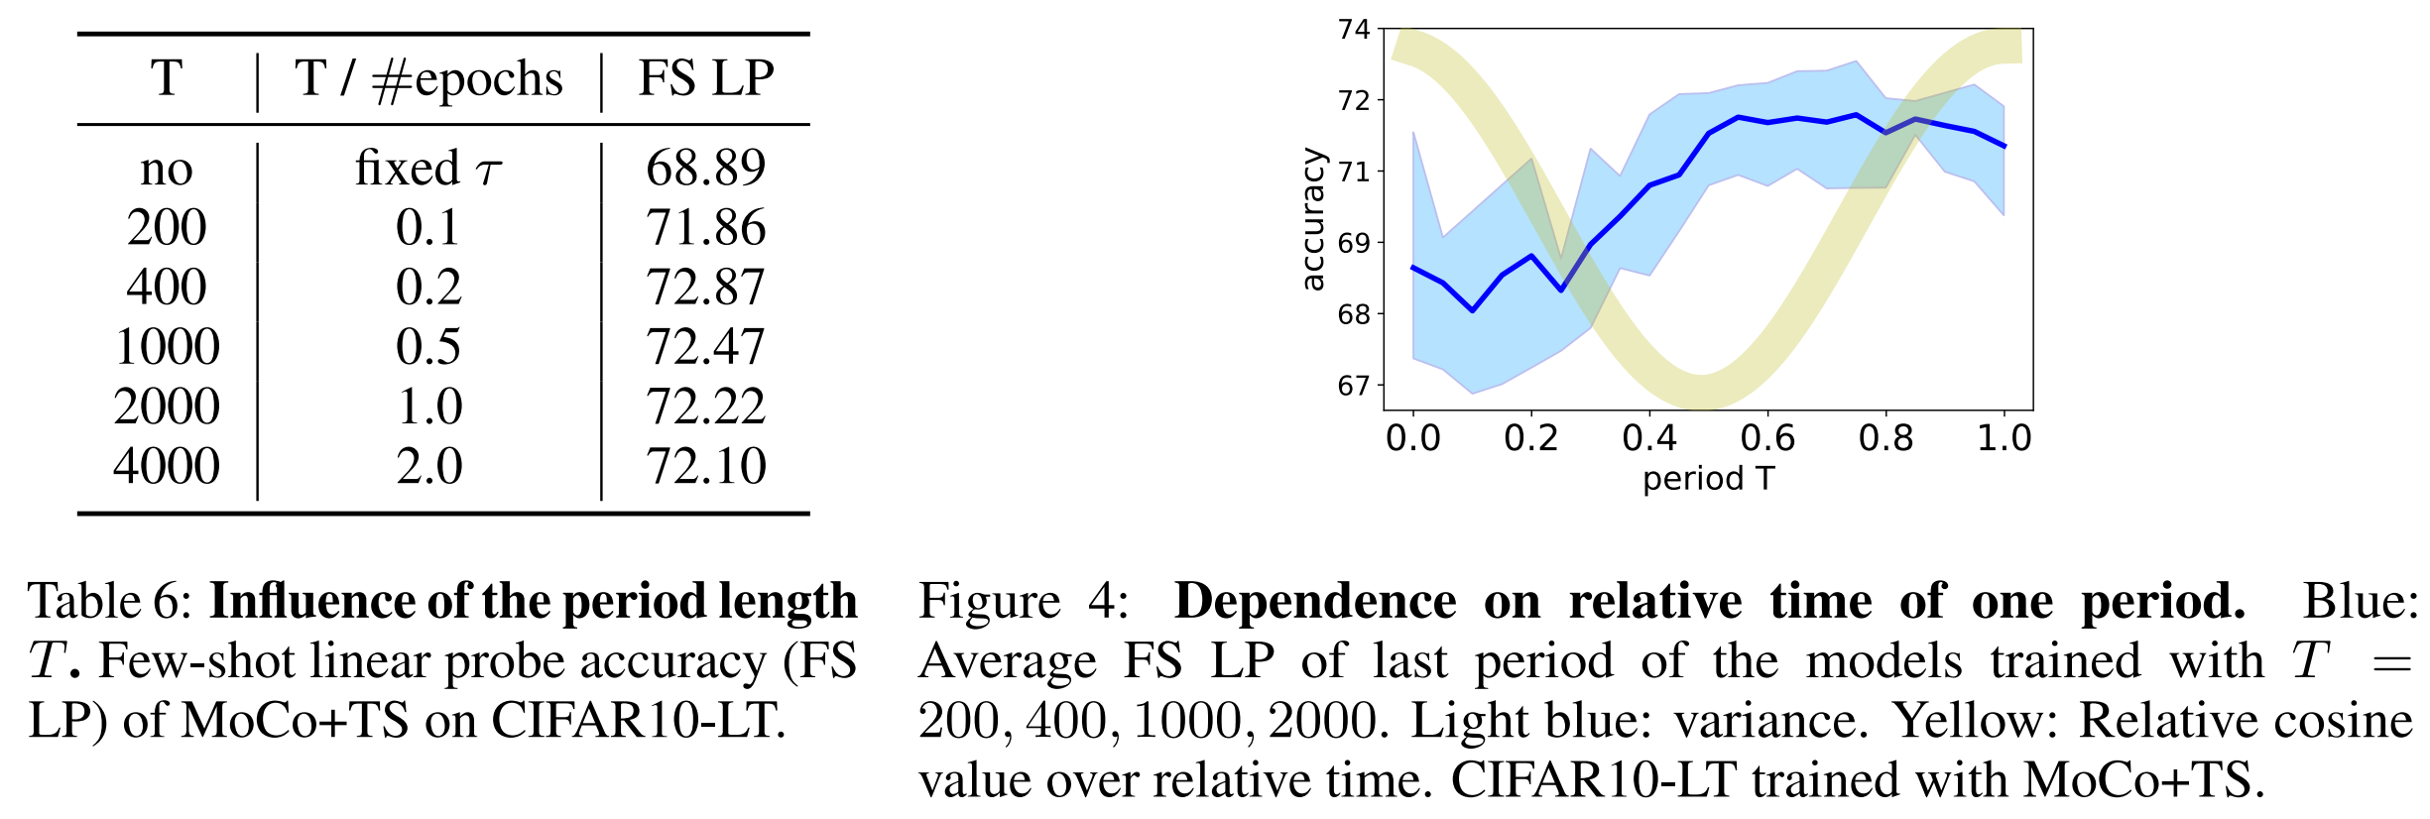

Slide 16
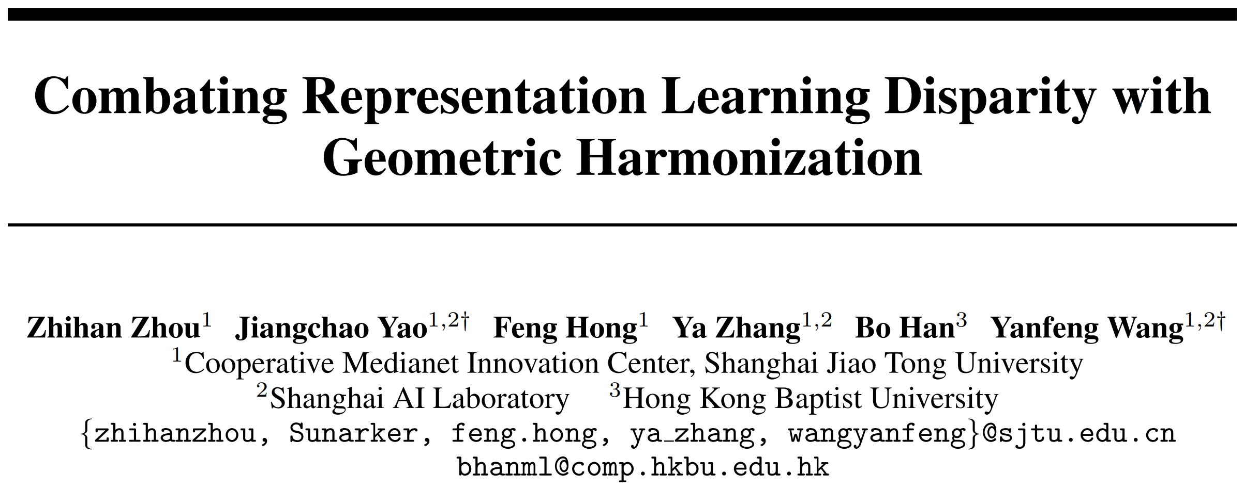
NeurIPS 2023 spotlight

Slide 17
Motivation: Conventional SSL methods, pursuing sample-level uniformity, easily leads to representation learning disparity where head classes dominate the feature regime but tail classes passively collapse.
Contributions:
We propose a novel Geometric Harmonization (GH) method to encourage category-level uniformity in representation learning to constrain the space expansion of head classes and avoid the passive collapse of tail classes.
Our proposal does not alter the setting of SSL and can be easily integrated into existing methods in a low-cost manner.
Extensive results on a range of benchmark datasets show the effectiveness of GH with high tolerance to the distribution skewness.
Conclusion: Geometric Harmonization (GH) as a regularization term + Neural Collapse

Slide 18
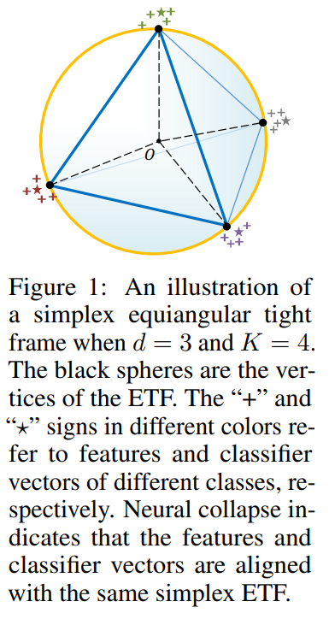
The last-layer features will converge to their within-class means, and the within-class means together with the classifier vectors will collapse to the vertices of a simplex equiangular tight frame (ETF) at the terminal phase of training on a balanced dataset.
Neural Collapse

Slide 19
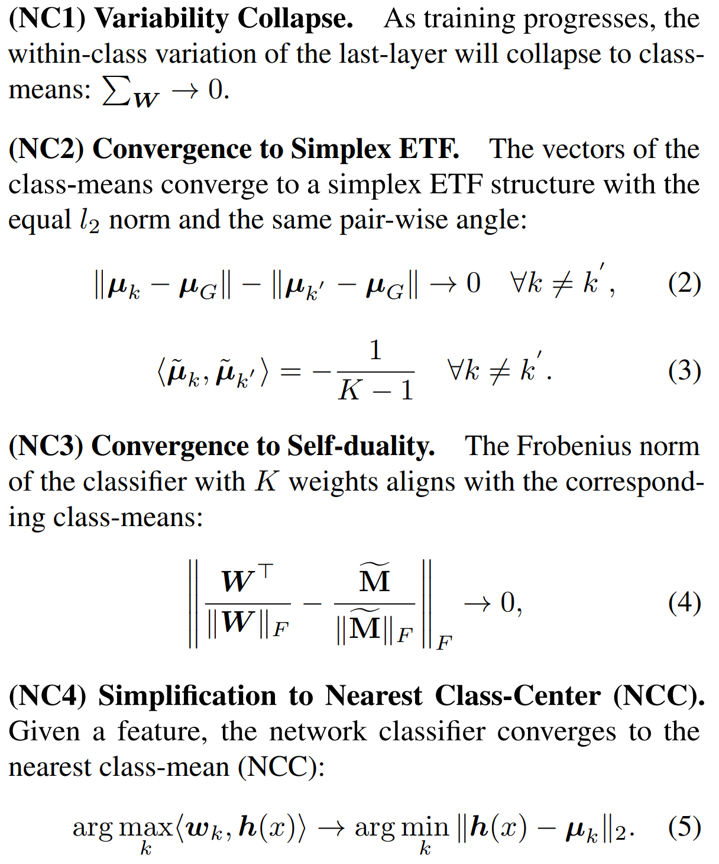
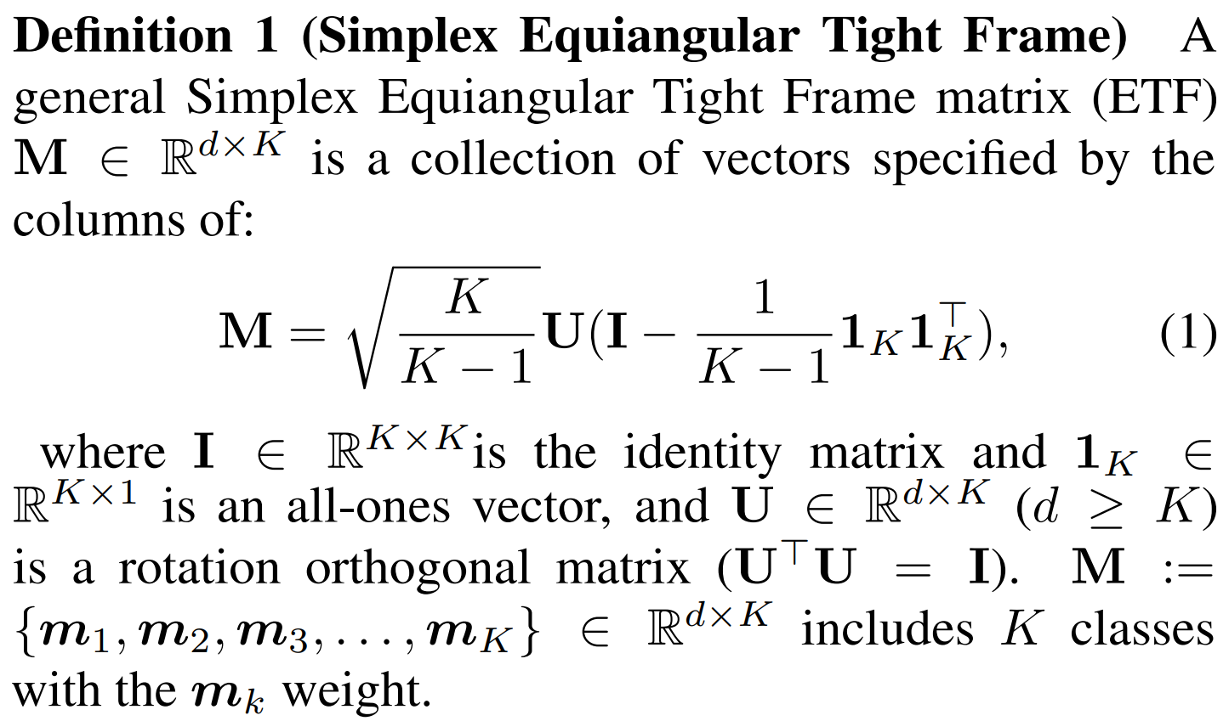

Slide 20
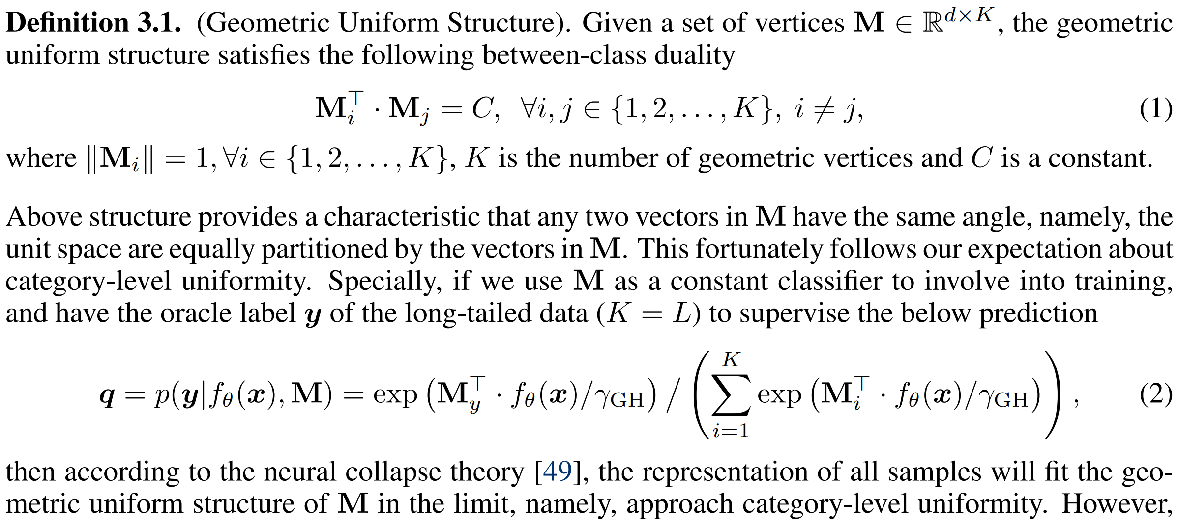

Slide 21
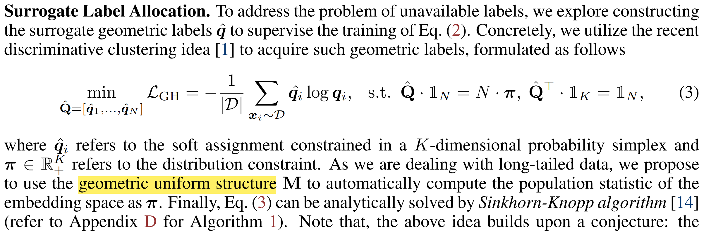
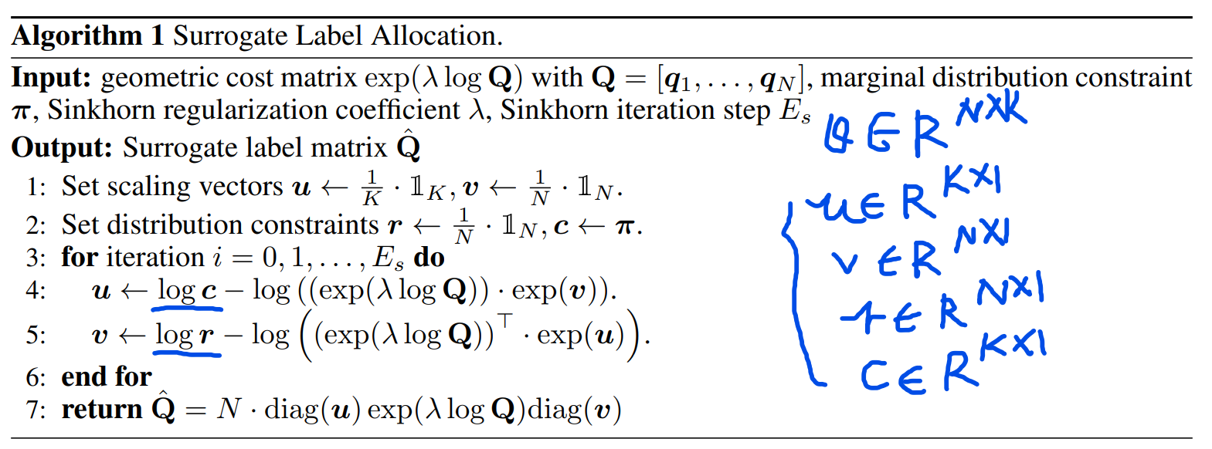

Slide 22
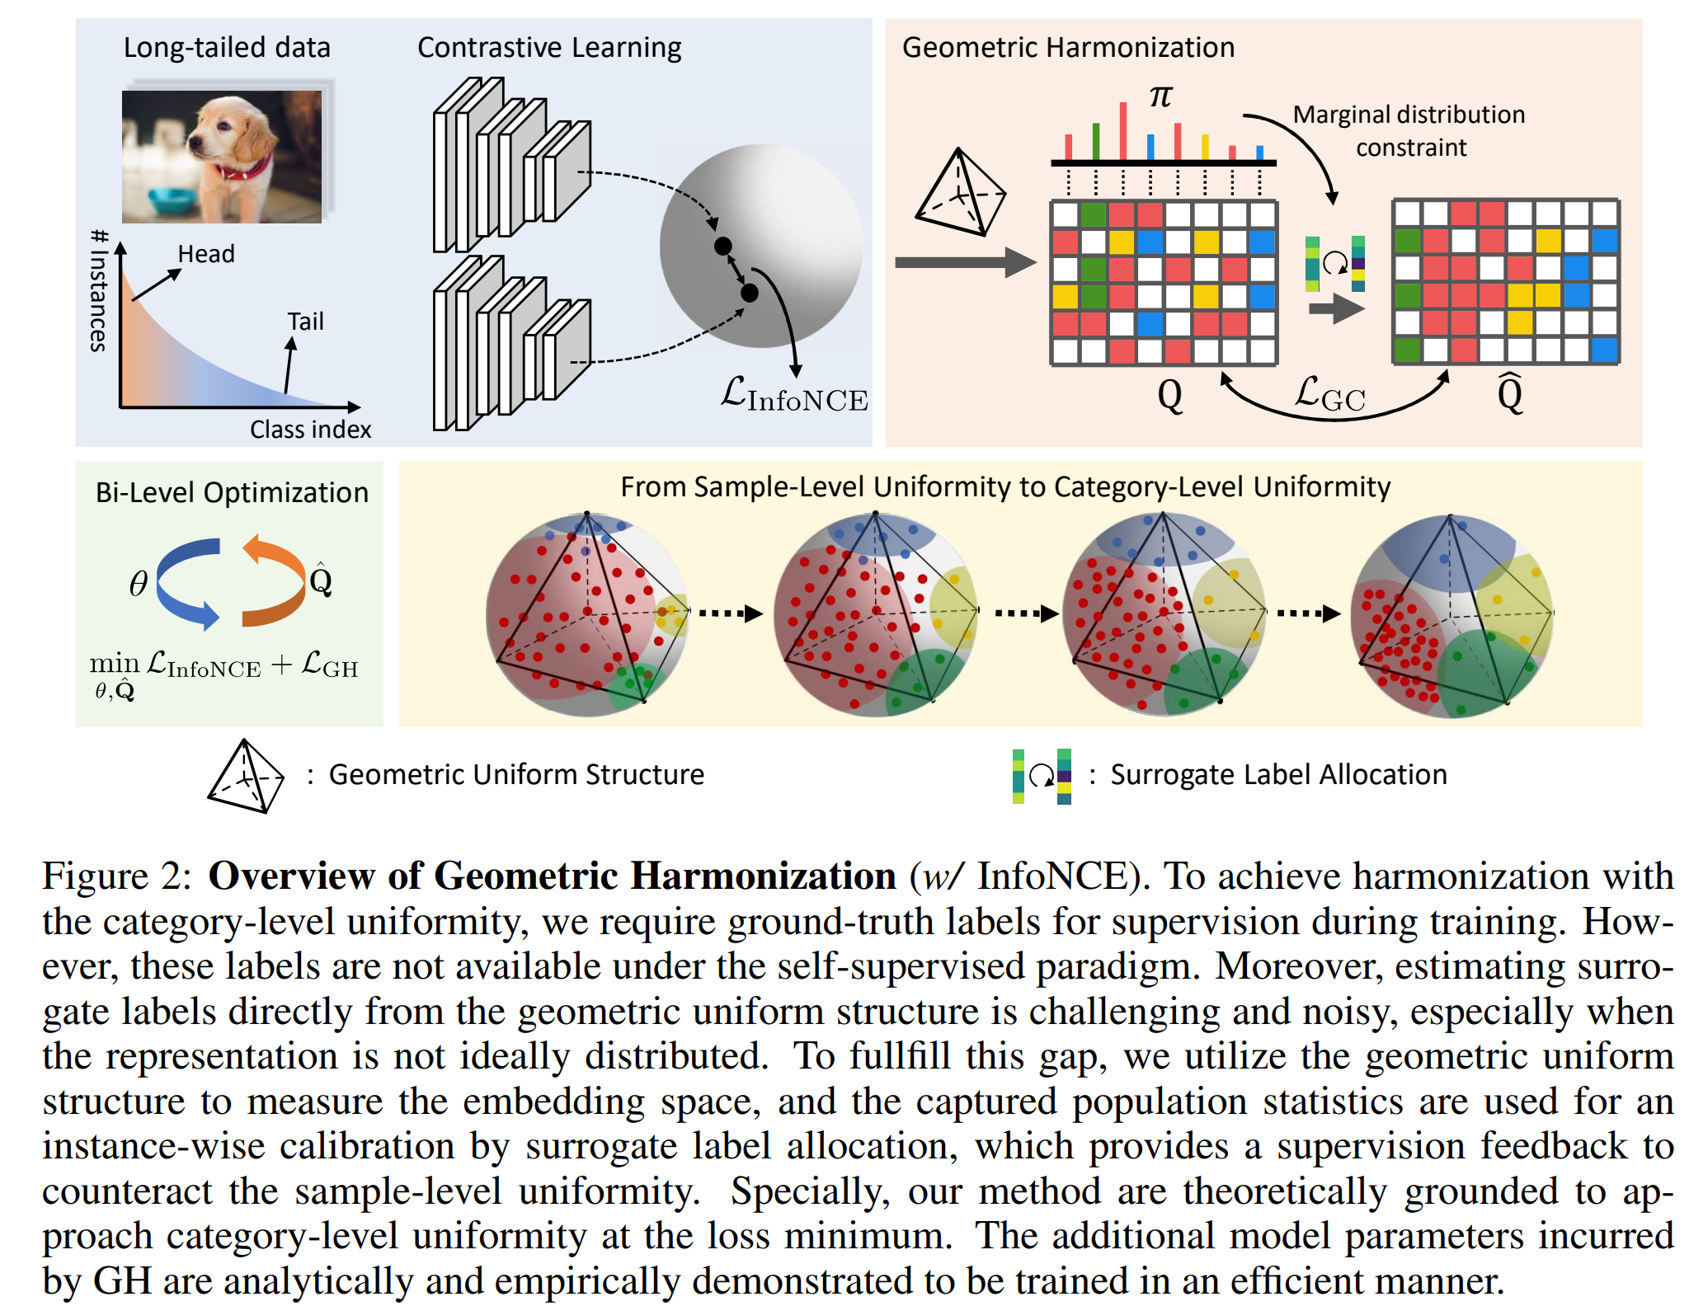

Slide 23
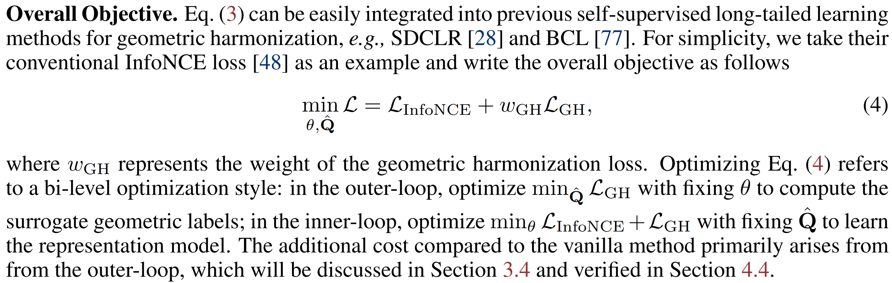

Slide 24
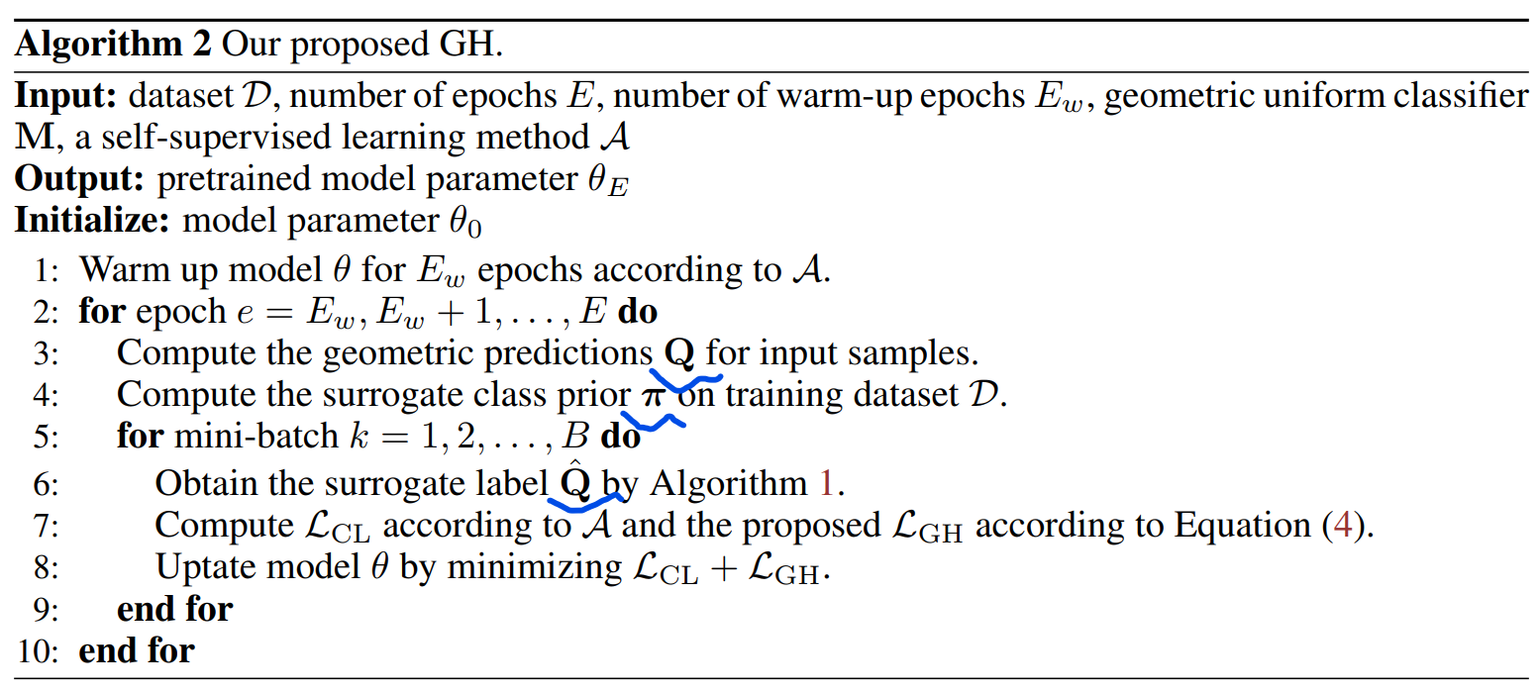

Slide 26
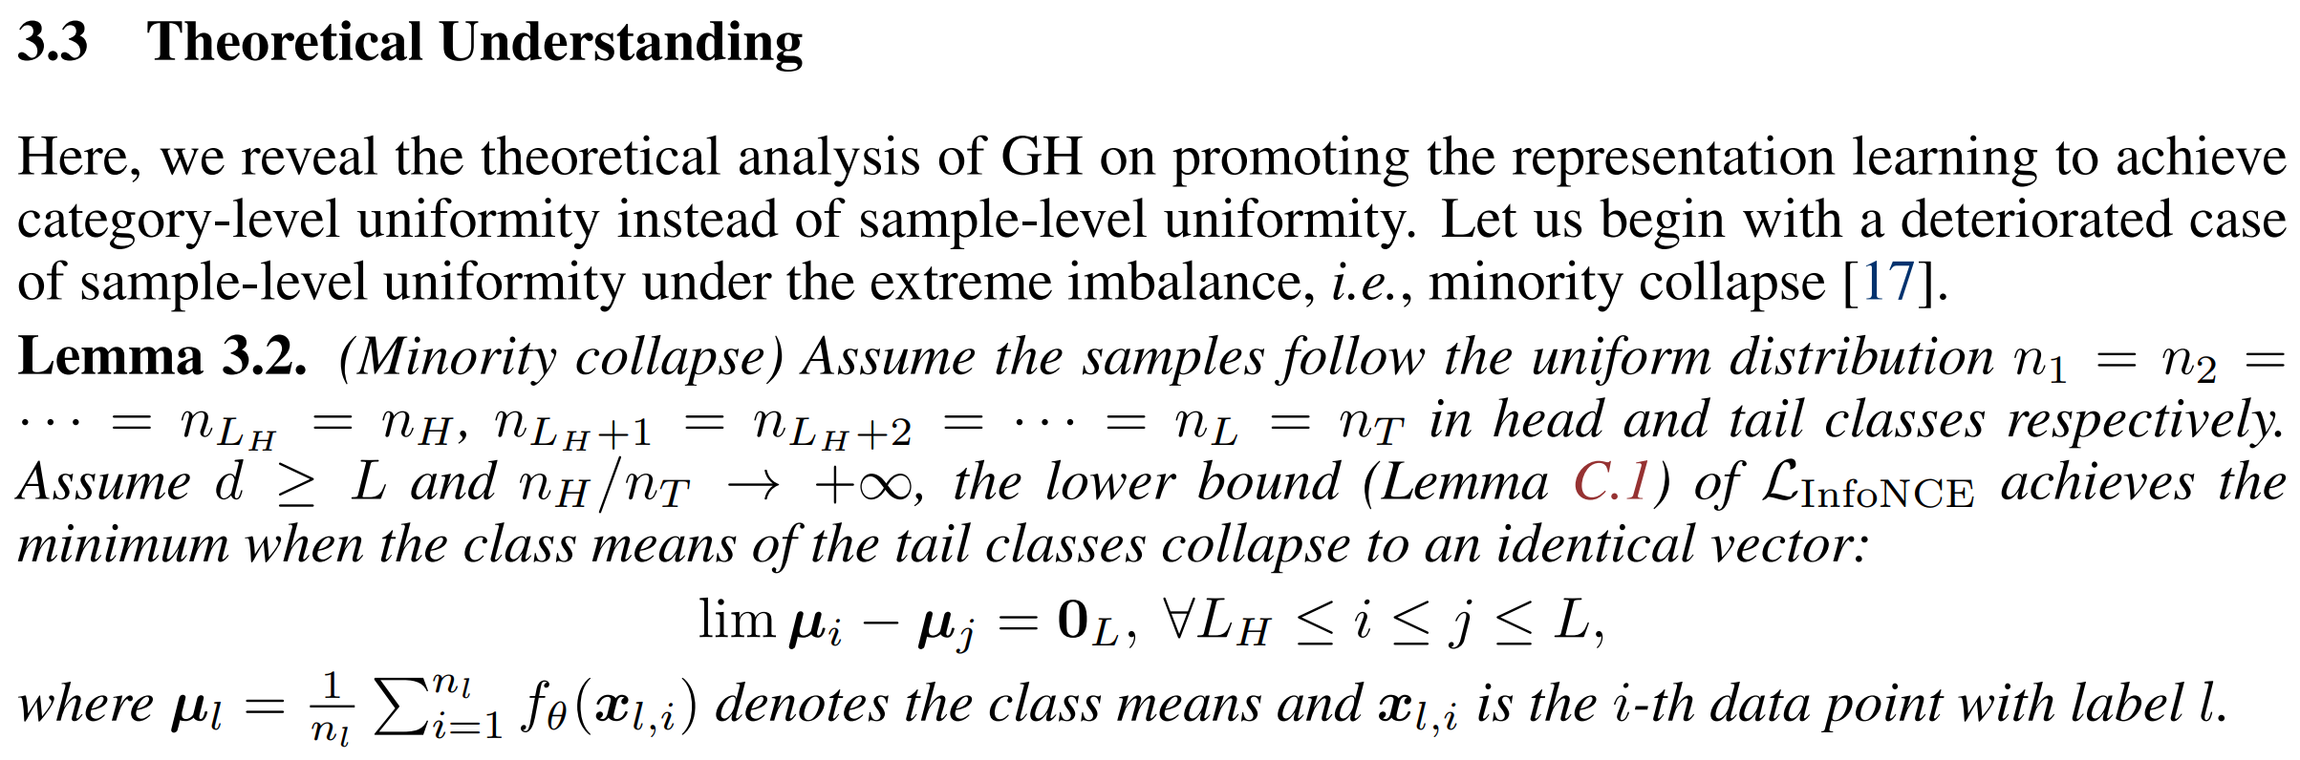
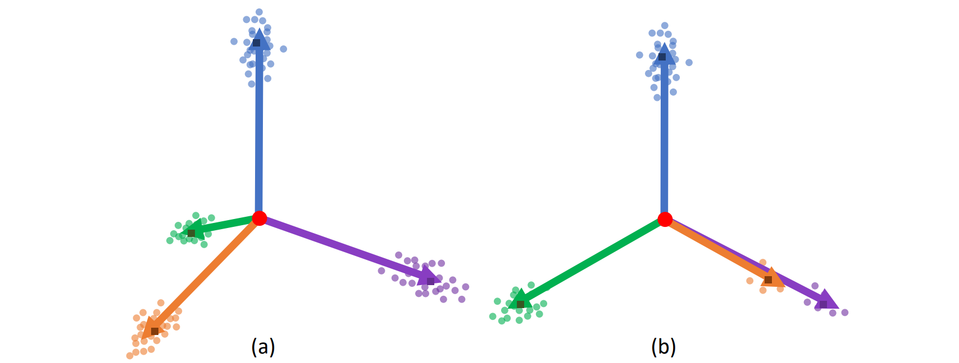

Slide 27
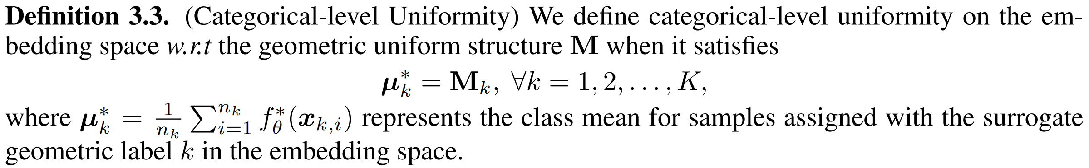

Slide 28
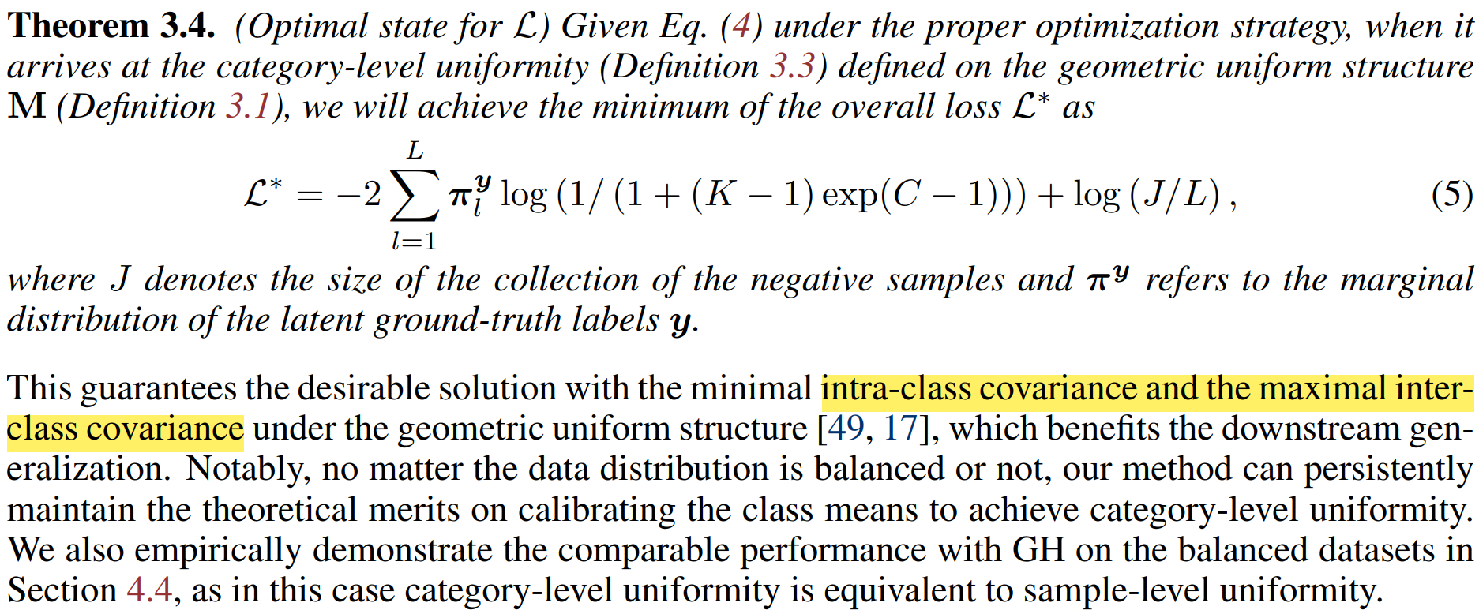

Slide 29
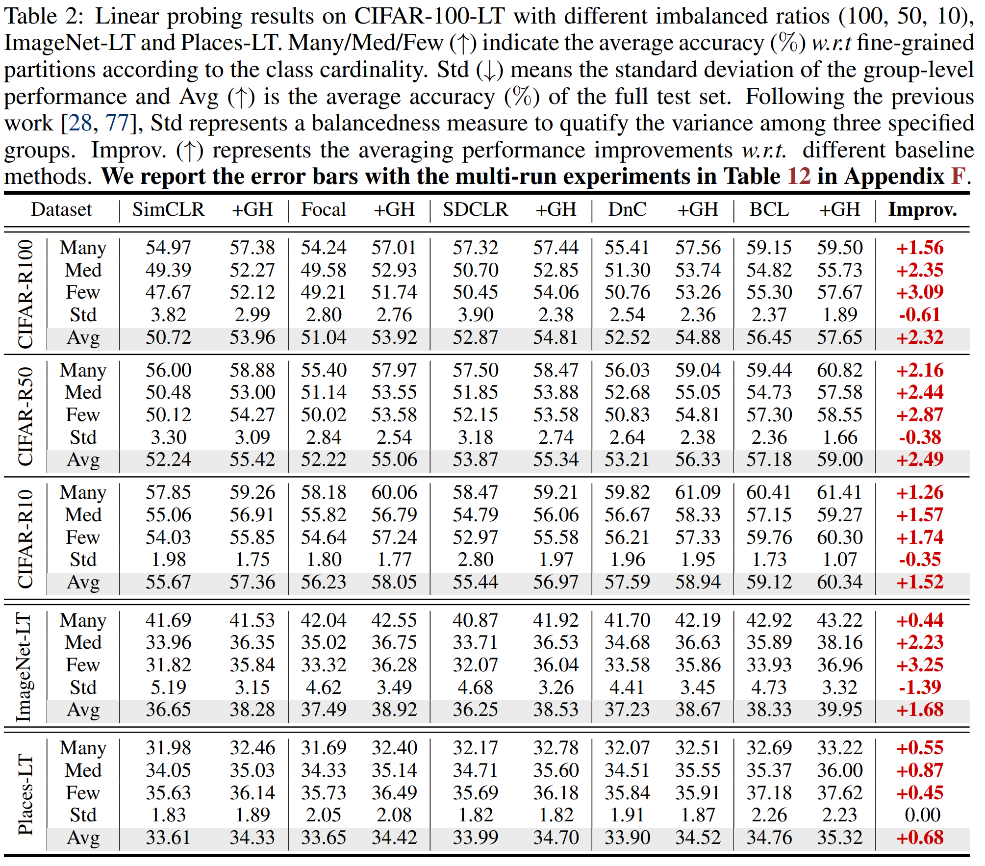

Slide 30
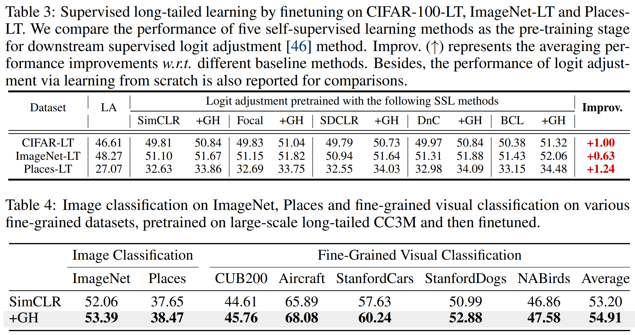

Slide 31
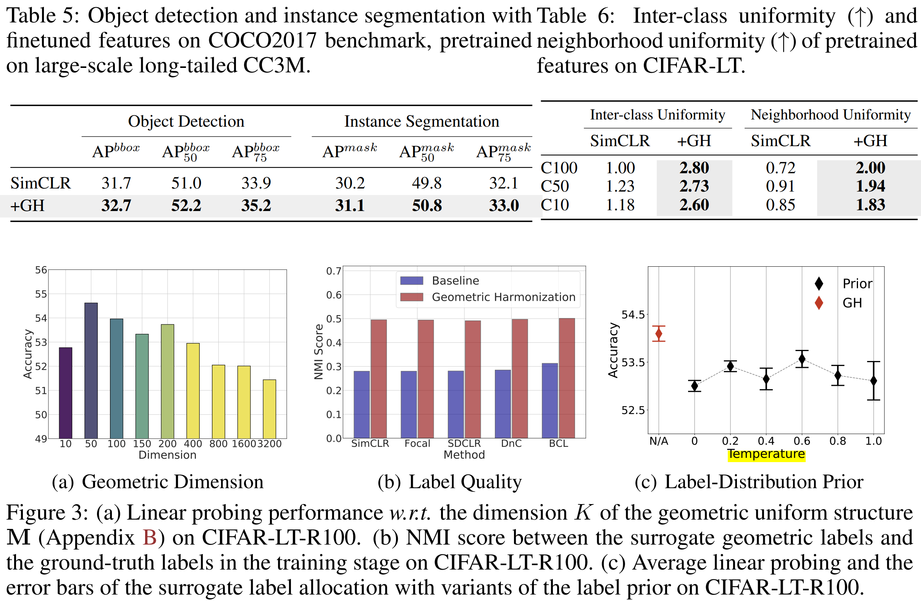

Slide 32
Appendix
[1] Contrastive learning with boosted memorization. ICML 2022.
[2] Self-damaging contrastive learning. ICML 2021.
[3] Divide and contrast: Self-supervised learning from uncurated data. ICCV 2021.
[4] Self-supervised learning is more robust to dataset imbalance. ICLR 2021.
[5] The hidden uniform cluster prior in self-supervised learning. ICLR 2023.

Slide 33
THANKS

